Slide 1
NE 591: Advanced Reactor Materials
Fall 2021
Dr. Benjamin Beeler

Slide 2
Sodium Cooled fast reactors

Slide 3
Sodium Cooled Fast Reactors (SFRs)
Two main families:
Liquid metal cooled reactor, which utilizes MOX fuel
Integral fast reactor, which utilizes metallic fuel
SFRs are designed for management of high-level wastes and, in particular, management of plutonium and other actinides
Important safety features of the system include a long thermal response time, a large margin to coolant boiling, a primary system that operates near atmospheric pressure, etc.

Slide 4
SFRs
Pool vs Loop
In the pool type, the primary coolant is entirely contained in the main reactor vessel, which therefore includes not only the reactor core but also a heat exchanger (US EBR-2, French Phénix)
In the loop type, the heat exchangers are external to the reactor tank (French Rapsodie, British Prototype Fast Reactor)

Slide 5
SFRs
Benefits of liquid metal coolants:
metals atoms are weak neutron moderators, allowing for fast neutron spectrum
sodium melts at 371K and boils at 1156K, a total temperature range of 785K between solid and gas states, whereas water is only 100K at atmospheric pressure
boiling temperature is well above operational temperatures
sodium is non-corrosive
sodium has higher thermal conductivity than water
Drawbacks:
sodium catches on fire in air, reacting with water to form hydrogen gas
requires special precautions to prevent and suppress fires and limit sodium leaks

Slide 6
Mixed Oxide (MOX) Fuel
Introduction
Fuel Restructuring
Constituent Redistribution
Geometrical Evolution
Evolution of O/M ratio
Migration of Fission Products
Fission Gas Release
Life Limiting Phenomena

Slide 7
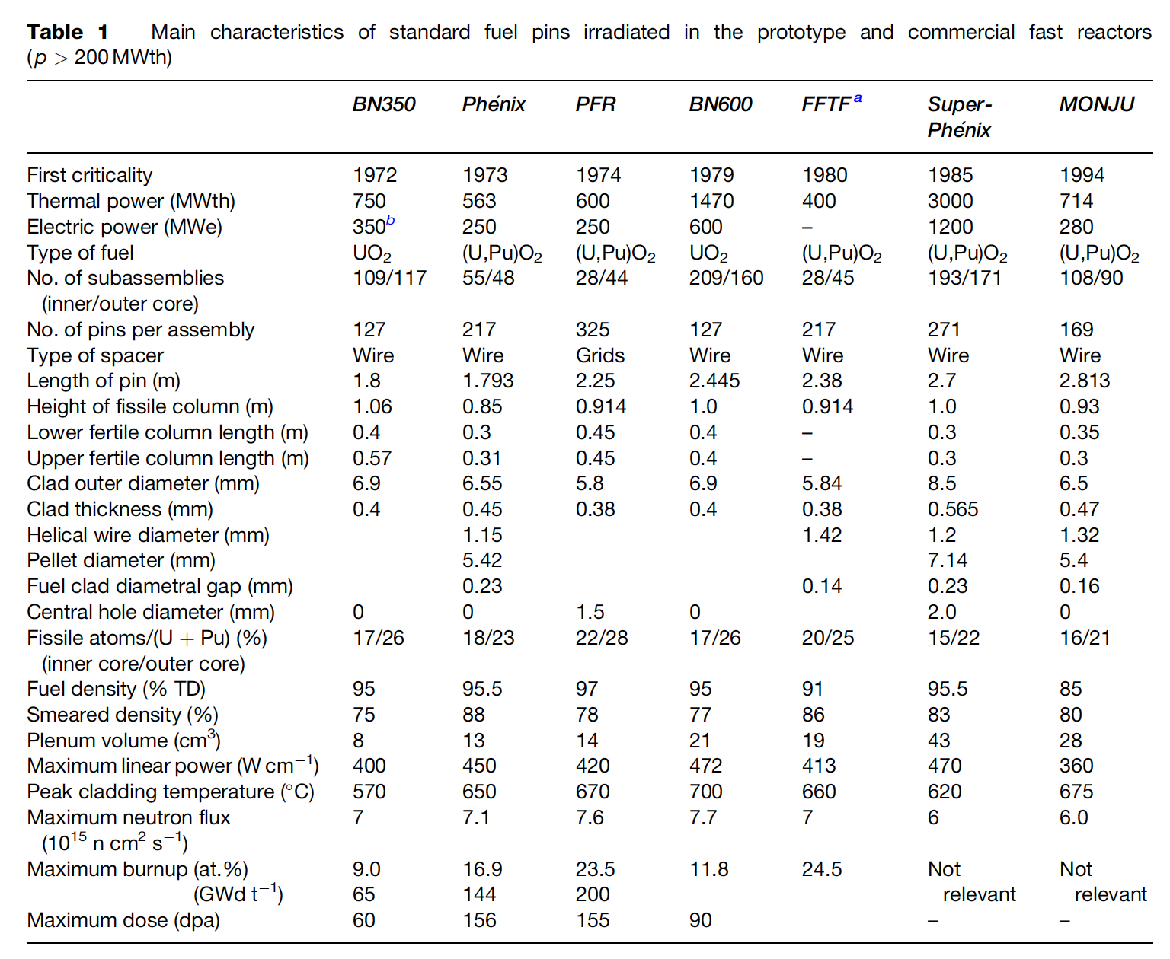
MOX Introduction
Despite some disadvantages, such as its low U density, poor thermal conductivity, and its chemical reaction with sodium, MOX fuel (U,Pu)O2 is the fuel that has been used most in fast reactors
In order to avoid the dramatic swelling of metallic fuels, MOX fuels were explored in fast reactors
Behavior was observed to be satisfactory and was relatively widely implemented in SFRs

Slide 8
Geometry
The fuel pin 2–3m long, 5–10mm diameter, clad in a steel tube 0.4–0.6mm thick closed in both ends by welded plugs

Slide 9
Metal Fuel
Introduction
Fabrication
Constituent Redistribution
Swelling and Fission Gas Release
FCMI
FCCI
Fission Product Behavior
Factors Controlling Fuel Lifetime

Slide 10
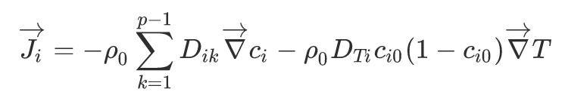
Soret Diffusion
Soret effect is a phenomenon observed in mixtures of mobile particles where the different particle types exhibit different responses to the force of a temperature gradient
The mass flux of ith component in a p components mixture can be written as
ρ_{o} is the specific mass or density, c_{i} is the mass fraction of the reference component with initial value equal to c_{io}, D_{ik} is the isothermal molecular diffusion coefficient, D_{Ti} is the thermodiffusion coefficient and ∇ci is the gradient of mass fraction induced by temperature gradient of ∇T

Slide 15
Questions?

